Slide 1
.NET of Things

Slide 2
What this talk is:
100 Level Overview
.NET

Slide 3
What this talk isn’t:
Electronics
Native C/C++
Anything Internet related

Slide 4
Word Cloud
C#
.NET Core
.NET Standard
UWP
Gadgeteer
.NET MicroFramework
TinyCLR OS
Meadow

Slide 5
Demo App
Ambient Light Sensor
When it gets too dark, Planet Express will light up
Button to make the Planet Express blink

Slide 6
Raspberry Pi
“Low Resources”
1.4 GHz 64 bit ARM CPU
1 GB RAM
Pi 3 B+
Exposed Pins
The Money Maker

Slide 7
Three Options
Windows 10 IoT
Mono on Linux
.NET Core on Linux

Slide 8
Windows 10 IoT

Slide 9
Pros
Cons
Meh?
Amazing tooling
Top Tier Debugging
Line-by-Line
Remote over USB (or network???)
No Generics Support
Required updates every few years

Slide 13
.NET MicroFramework
Legacy
Designed for MCUs
RAM ~300KB
CPU like Cortex-M3 @ 120 MHz
Limited in features
No generics
Limited MCU selection
Open Source
http://netmf.github.io/
Netduino 2 courtesy of https://www.wildernesslabs.co/

Slide 14
Cons
Limited Language Feature Support
No Generics
Required VS Extension to begin
Only worked on Community Version of VS
Maxed out at VS 2015

Slide 15
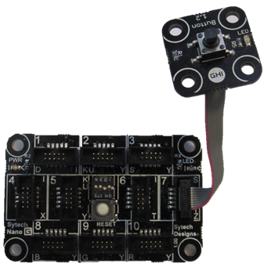
Gadgeteer
Extension of .NET MicroFramework
Easy Prototyping Platform
Expensive
Open Source
https://archive.codeplex.com/?p=gadgeteer
GHIElectronics FEZ Hydra
with Button module

Slide 18
TinyCLR OS
Created by GHI Electronics
https://www.ghielectronics.com/tinyclr/features
Can be ported to custom hardware
Modules hosted on NuGet
Not open source
Though documentation is
Supports native C/C++ code
No Generics Support

Slide 19
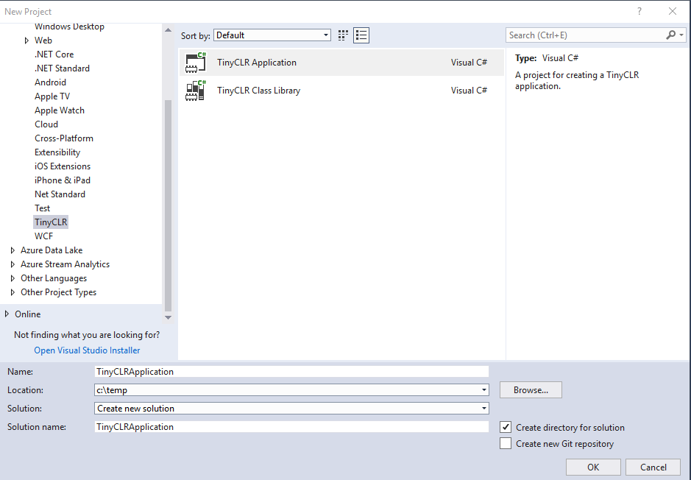
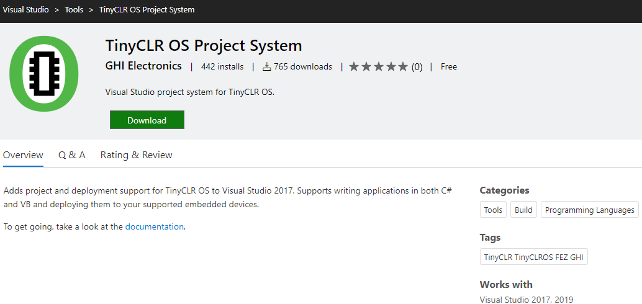
TinyCLR OS – Getting Setup
Follow simple instructions online
https://docs.ghielectronics.com/software/tinyclr/getting-started.html
Install “TinyCLR OS Project System” Extension to VS
https://marketplace.visualstudio.com/items?itemName=ghielectronics.tinyclr-projectsystem
Create new project

Slide 20
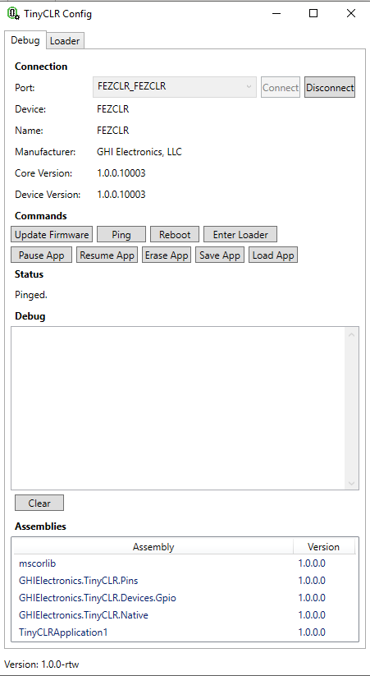
TinyCLR Config
Application to update device Firmware
Debug board
Might need this on first use of new board

Slide 21
Pros
Cons
NuGet Packages
Line-by-Line Debugging
No Generics Support
Can’t reference .NET Standard Libraries

